Slide 1
Website Development Overview
Current Features and Future Enhancements

Slide 2
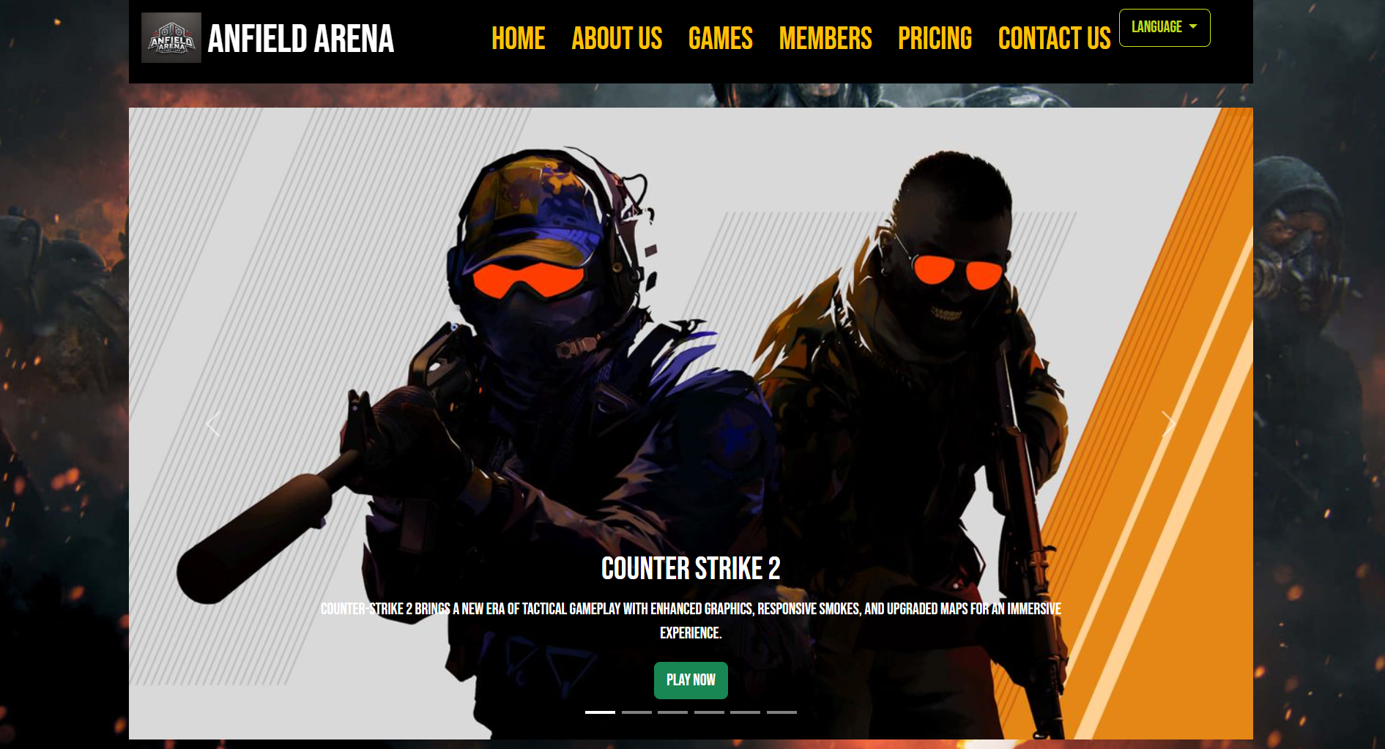
Current Features
Responsive layout for different devices
Navigation bar with language switching
Home page with interactive carousels (images and videos)
The website has been designed with a fully responsive layout to ensure seamless functionality across various devices, providing an optimal user experience whether accessed on a desktop, tablet, or smartphone. The navigation bar incorporates a convenient language-switching feature, catering to a diverse audience and enhancing accessibility. Additionally, the home page offers dynamic interactive carousels that display captivating images and videos, creating a visually engaging and immersive experience for users.

Slide 3
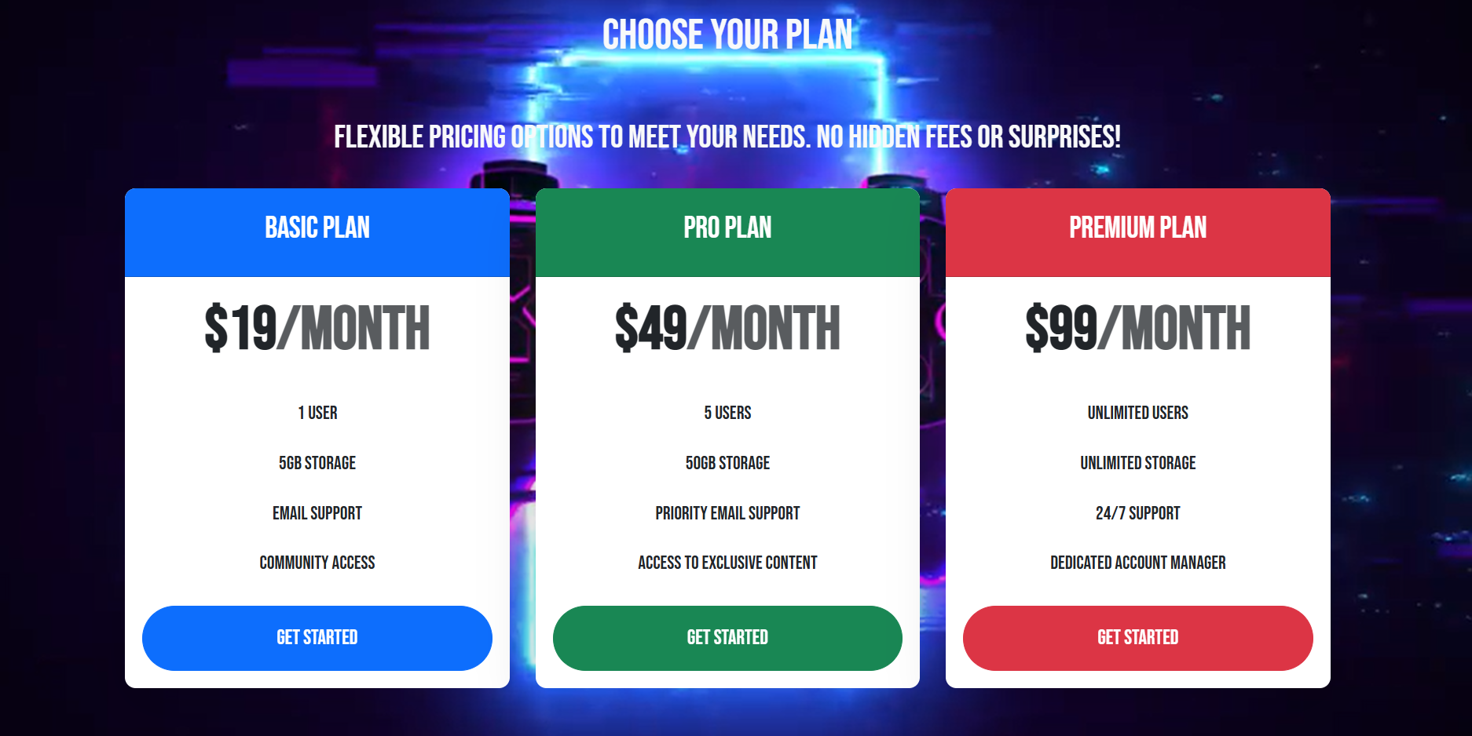
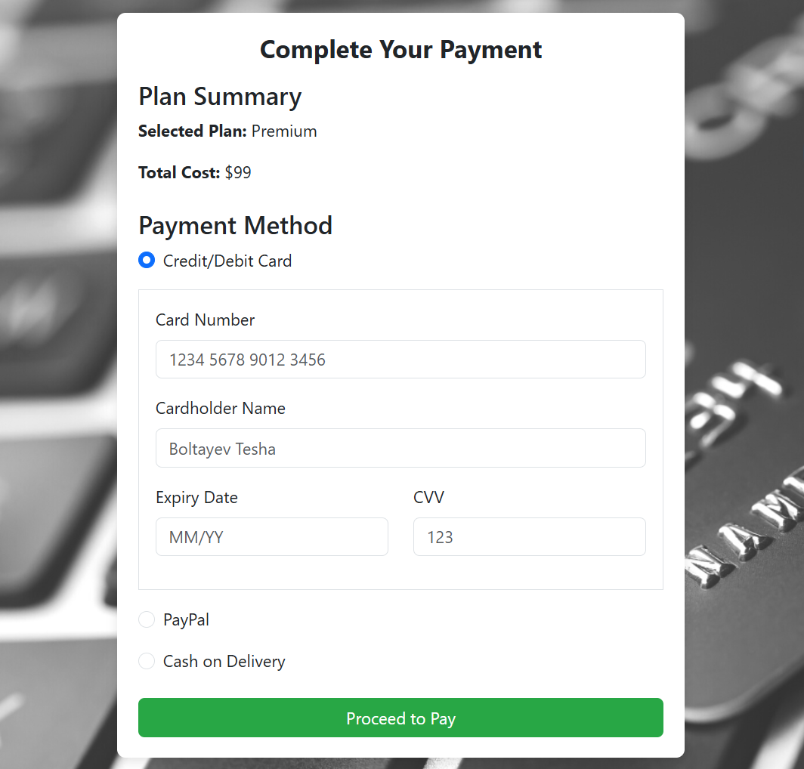
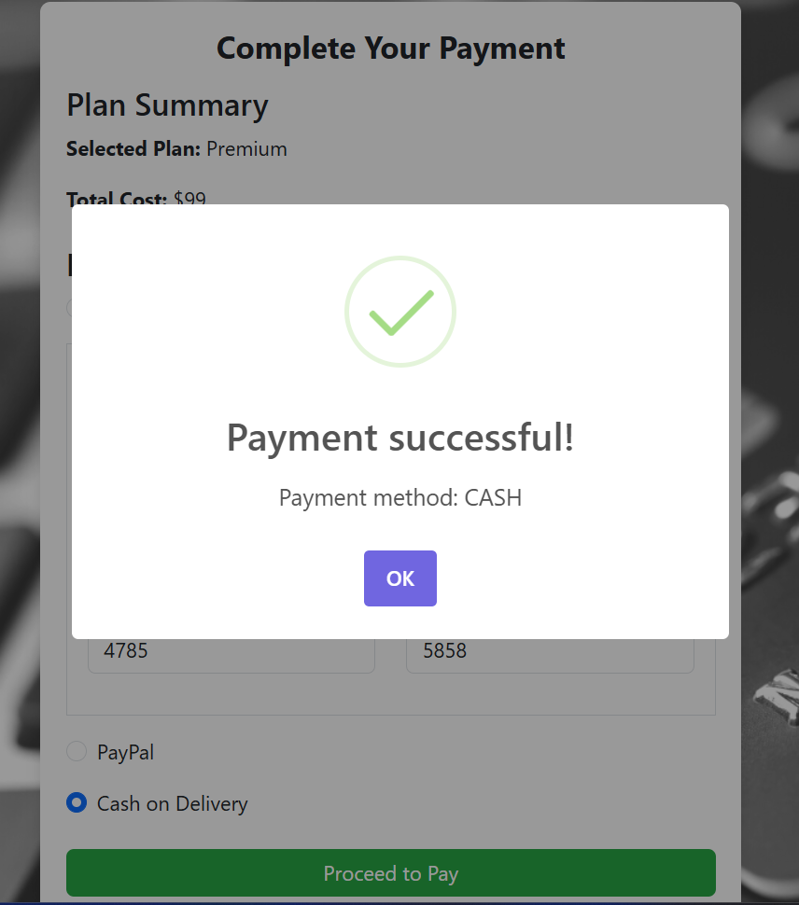
Payment page with various options
Contact form with validation and success alerts
The payment page is equipped with multiple payment options, ensuring flexibility and convenience for users to complete their transactions seamlessly. Furthermore, the contact page features a fully functional form with robust validation to ensure data accuracy. Upon successful submission, users receive interactive success alerts, enhancing the overall user experience and reliability of the website.

Slide 4
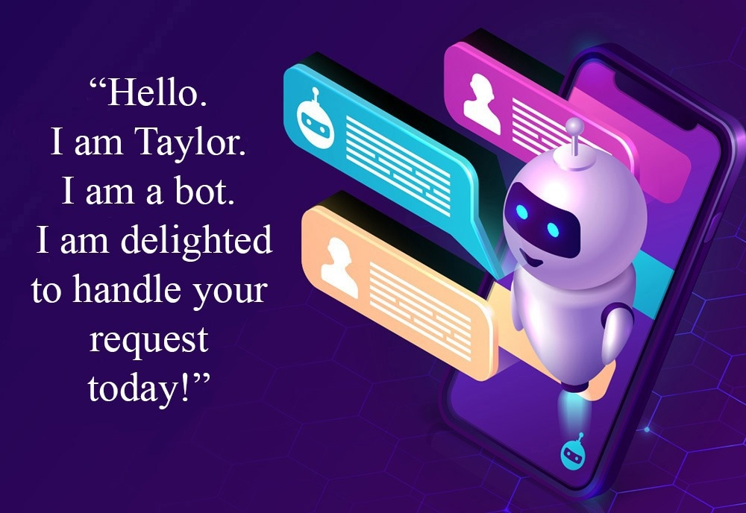
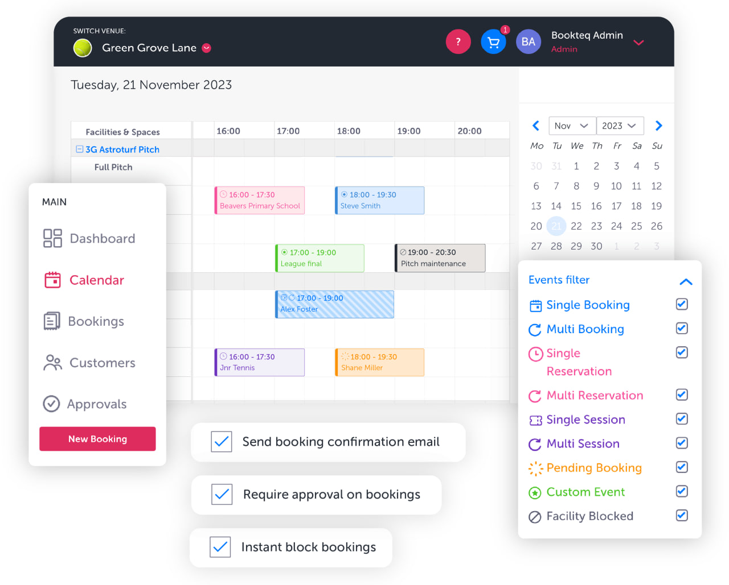
Future Enhancements
AI-powered chatbot for user support
Integrated game booking system
The website incorporates an AI-powered chatbot to provide efficient and instant user support, addressing queries and enhancing customer satisfaction. Additionally, an integrated game booking system streamlines the reservation process, offering users a hassle-free way to secure their preferred gaming sessions.

Slide 5
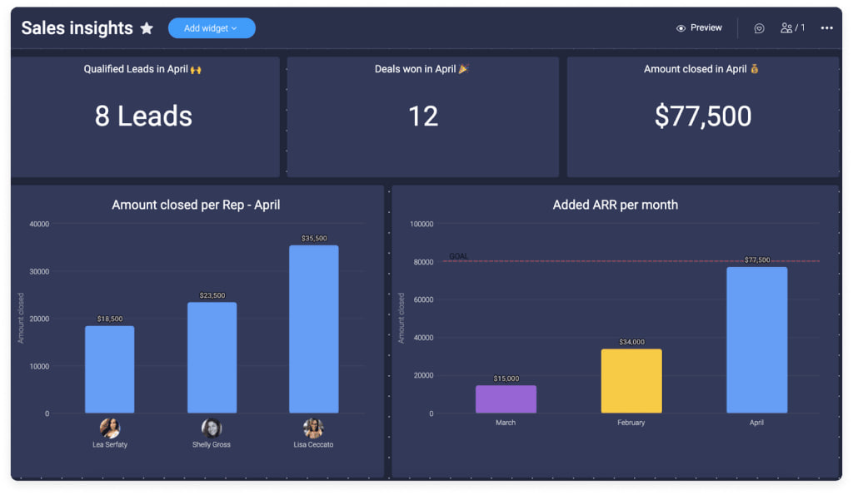

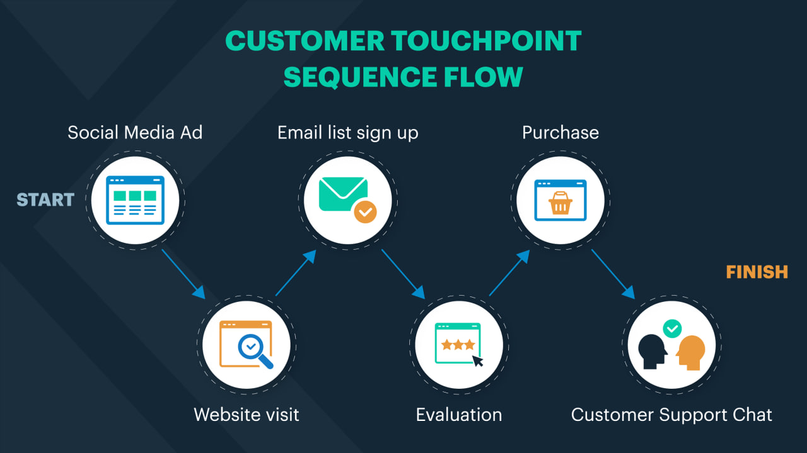
Personalized user dashboard
Advanced analytics and user feedback system
Modern and immersive design improvements
The platform will feature a personalized user dashboard, providing tailored content and easy access to user-specific information. It will also include an advanced analytics and user feedback system, enabling better insights into user behavior and preferences. Furthermore, modern and immersive design enhancements will ensure a visually appealing and engaging experience for all users.

Slide 6

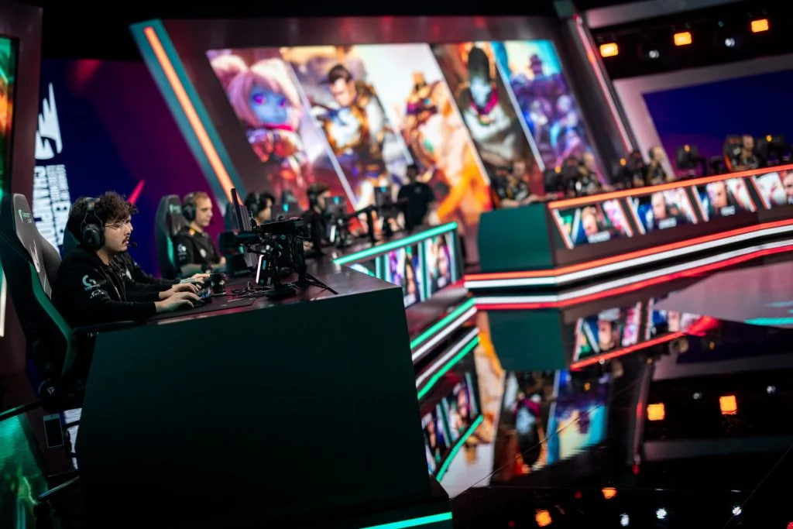
Franchise Opportunities
Esports Tournaments & Events
Expanding into new locations could open the door for franchising opportunities, which would help accelerate growth and streamline the process of opening new branches. With more branches, Anfield Arena can host esports tournaments and events simultaneously, increasing its capacity for attracting sponsors, players, and fans. This could also make the arena a central hub for competitive gaming in different regions.

Slide 7
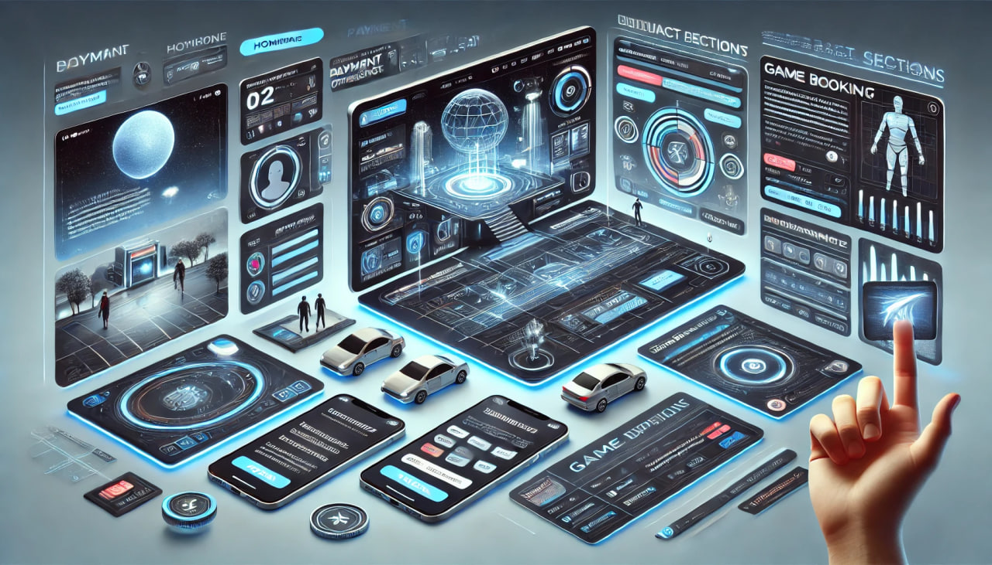
Visual Mockup of Future Website
A visual mockup of the future website illustrates the anticipated design and functionality enhancements, providing a clear representation of how the platform will look and operate once the planned updates are implemented.

Slide 8
Thank you for your attention
Anfield Arena Team

